Slide 1

Great Offense vs. Stout Defense
By Chad Schneider

Slide 2
Table Of Contents
The Question
Dataset
EDA
Modeling
Evaluation
Results
Conclusion

Slide 3
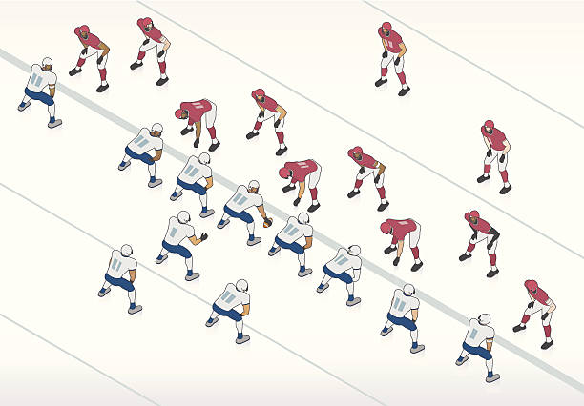
The Question
Does having a better NFL offense or defense give you a better opportunity at making the NFL playoffs?

Slide 4
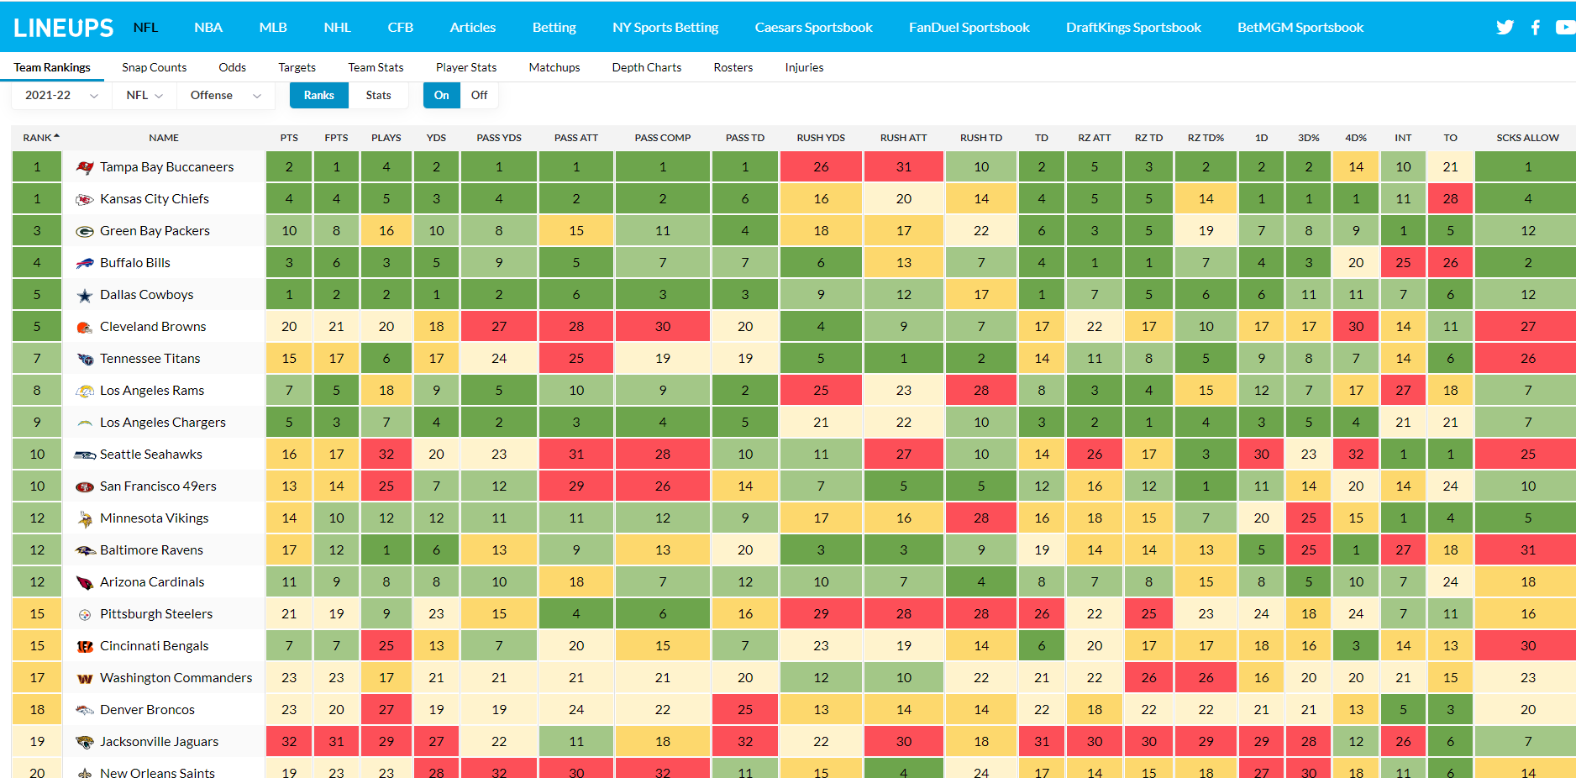
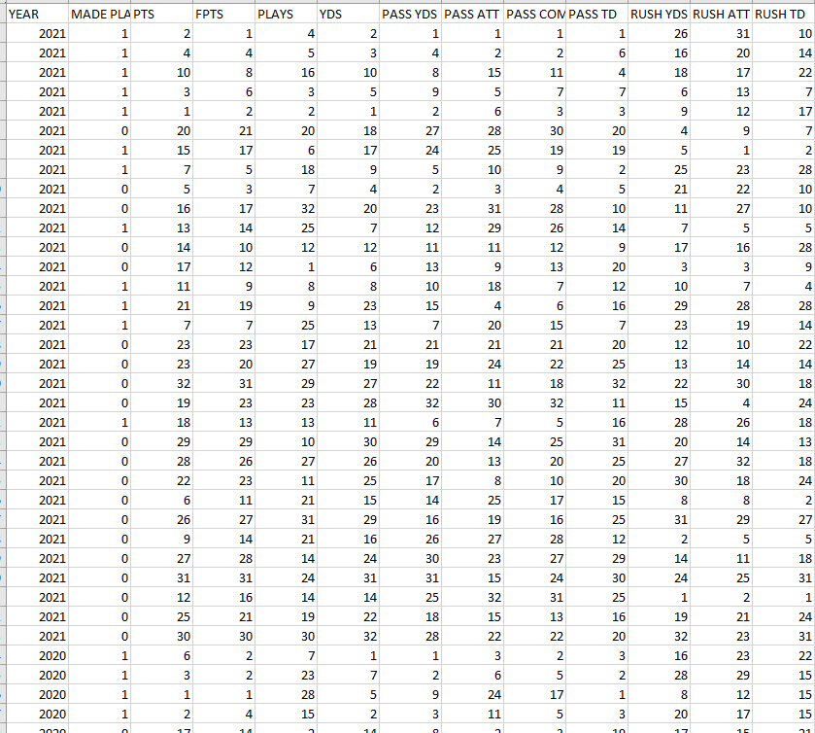
Dataset
Exported both offensive and defensive yearly rankings from 2017-2021 seasons into created .csv and added whether each team made playoffs that year as YES or NO from per NFL.com
https://www.lineups.com/nfl-team-rankings

Slide 5
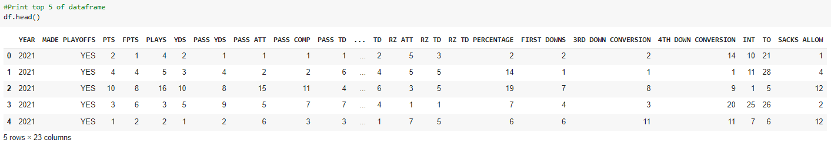
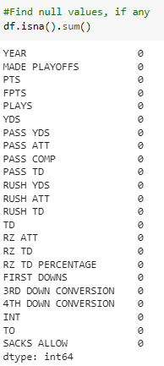
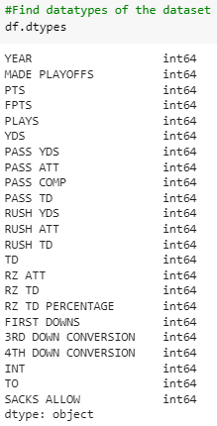
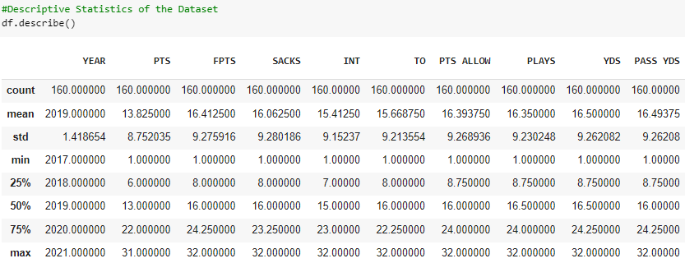
EDA
No Nulls To Remove
All Integers So No Encoding Necessary
Ranking Ranges from 1-32; No Standardization/Normalization Necessary

Slide 6
Models, Predictors, and Responses
Offense Model:
Predictors:
Passing Yards, Passing Completions, Passing Touchdowns, Rushing Yards, Rushing Touchdowns
Response:
Made Playoffs
Defense Model:
Predictors
Passing Yards Allowed, Passing Completions Allowed, Passing Touchdowns Allowed, Rushing Yards Allowed, Rushing Touchdowns Allowed
Response
Made Playoffs

Slide 7
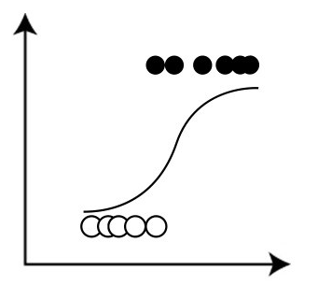
Selected Models
Classification Models Used:
Logistic Regression Model
Naïve Bayes Model
Lasso Logistic Regression Model
Ridge Logistic Regression Model
K-Nearest Neighbors with K = 5
Support Vector Machine Models
SVM Linear
SVM Polynomial Kernal
SVM Radial Basis Function Kernal

Slide 8
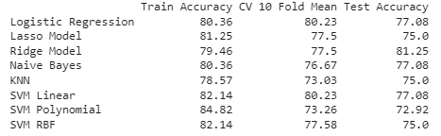
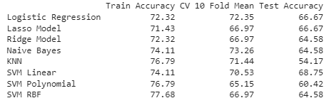
Evaluation
Offensive Models
Average Accuracy
75.75
75.14
73.85
73.87
68.59
77.04
72.83
74.77
Defensive Models
Average Accuracy
70.45
68.36
67.86
70.65
67.47
71.13
67.45
69.74

Slide 9
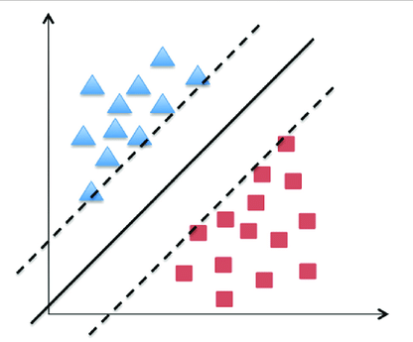
Results
The support vector machine linear model had the best average performance across both offense and defense model sets.
The offensive models performed better as a predictors on training accuracy, 10 fold cross validation mean, and the unseen test data.
Based on this information, NFL general managers today should invest more on the offensive side of the team during the draft and free agency to ensure potential playoff appearances.

Slide 10
Conclusion
Creating the .csv minimized the amount of EDA and data manipulation I have to do.
Using yearly rankings vs. actual output was a better approach because it standardized the data accounted for the league shifting towards higher offensive output numbers towards the recent years.
ADA/gradient boost and decision tree models were heavily overtrained to this smaller dataset.
My hunch was offense was going to prevail based on my knowledge of the league and how it has changed, but may get different understanding by modeling a different timeframe or statistics.

